Slide 1
Does Employee Satisfaction Affect Employee Engagement?
Shuaib Baksh

Slide 2

Table of Content
Employee Engagement importance
Answer Key Questions
Recommendation
Notes:
With 848,000 employees
From 500 Companies
And 1283 locations
From 2008 – 2021

Slide 3
Employee Engagement
Shaw (2005) defined engagement as ‘translating employee potential into employee performance and business success’.
International Survey Research (ISR) defines employee engagement as ‘a process by which an organization increases commitment and continuation of its employees to the achievement of superior results’.
The ISR separates commitment into three parts:
cognitive commitment,
affective commitment
behavioral commitment.
Notes:
Shaw - This means changing the way employees perform ‘by utilizing the tools in the armory of internal communication professionals’.
- the three dimensions are: think, feel and act.

Slide 4

Employee Engagements Drivers
Job Satisfaction
Work-Life Balance
Career oppurtunities
Culture and Values
Diversity and Inclusion
Compensation and Benefits

Slide 5
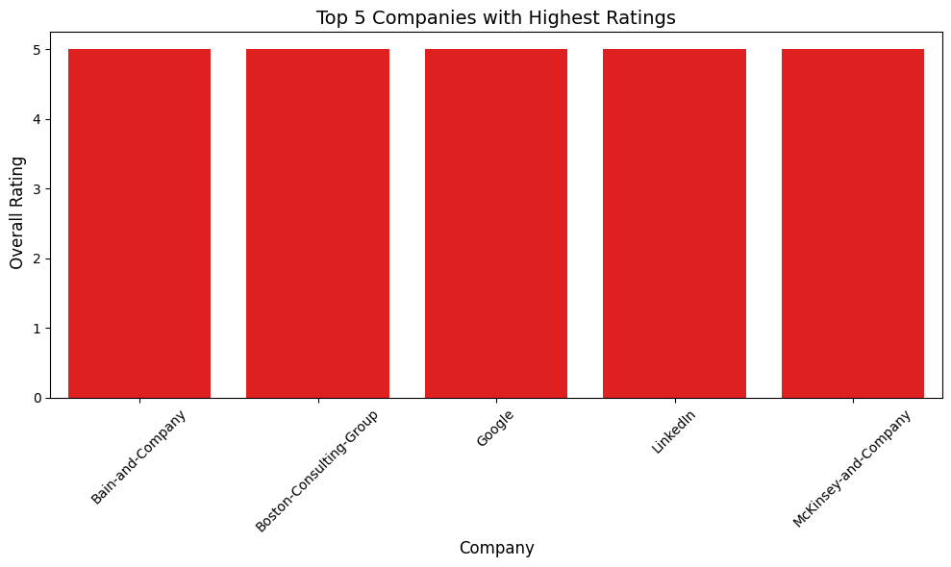
Top Rated Companies by Employees

Slide 6
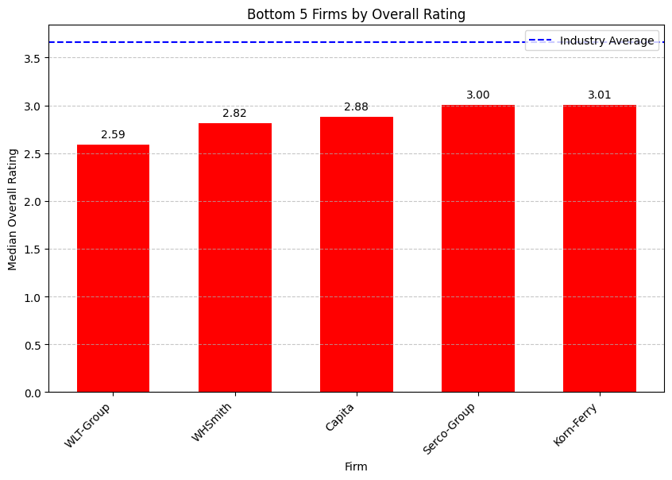
Bottom Rated Companies by Employees

Slide 7
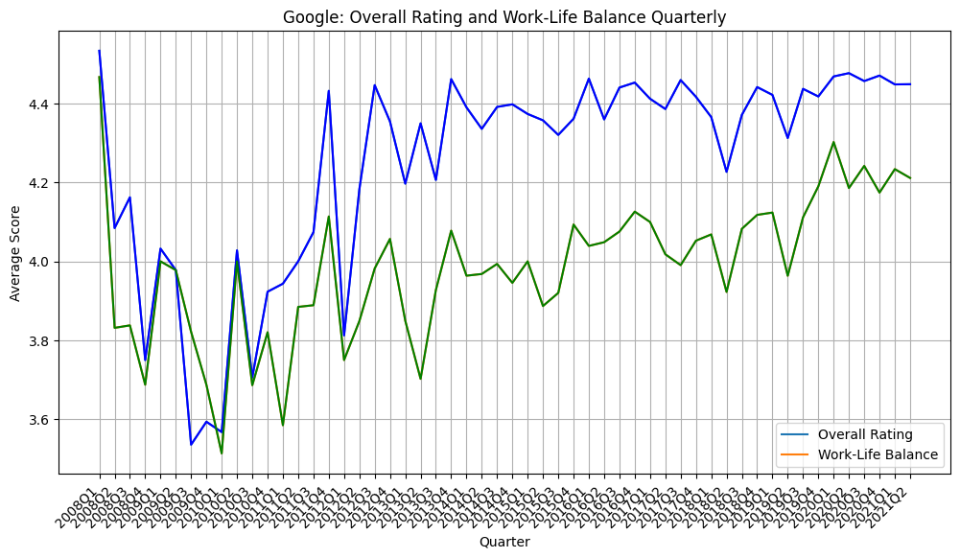
Google Overall Rating and Work-Life Balance

Slide 8
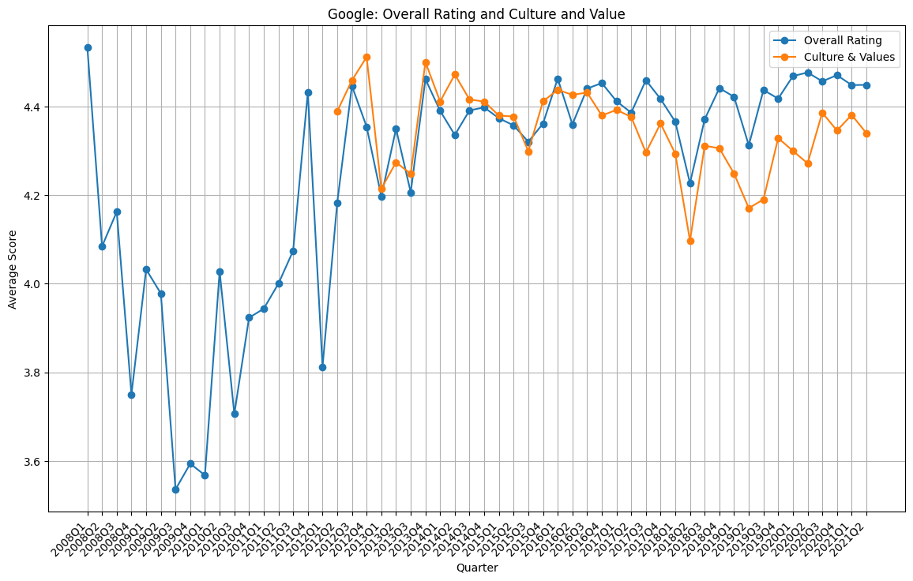
Google Overall Rating and Culture and Value

Slide 9
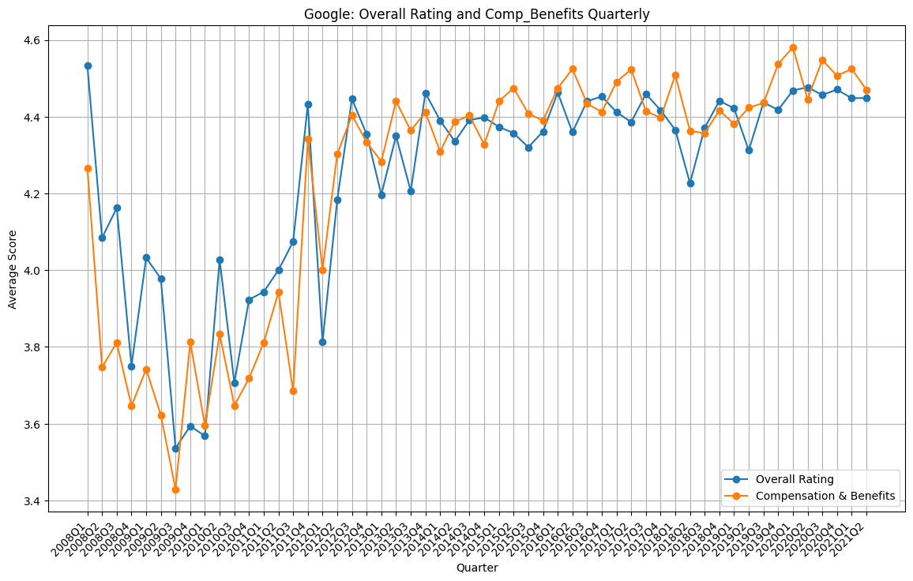
Google Overall Rating and Comp and Benefits

Slide 10
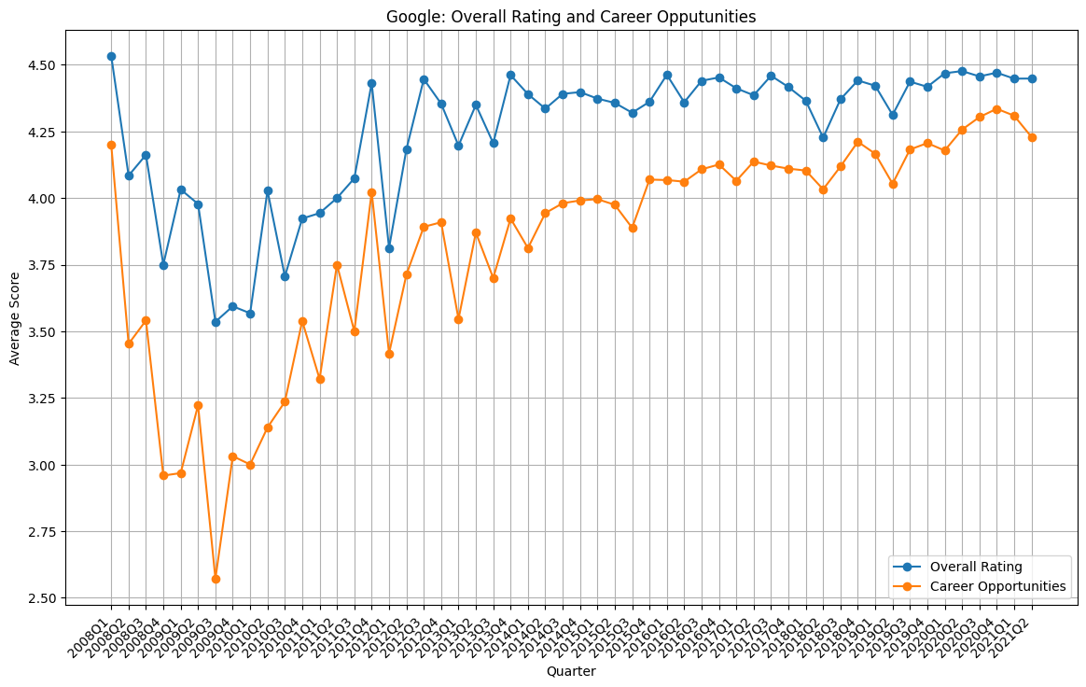
Google Overall Rating and Career Oppurtunities

Slide 11
WLT Group

Slide 12
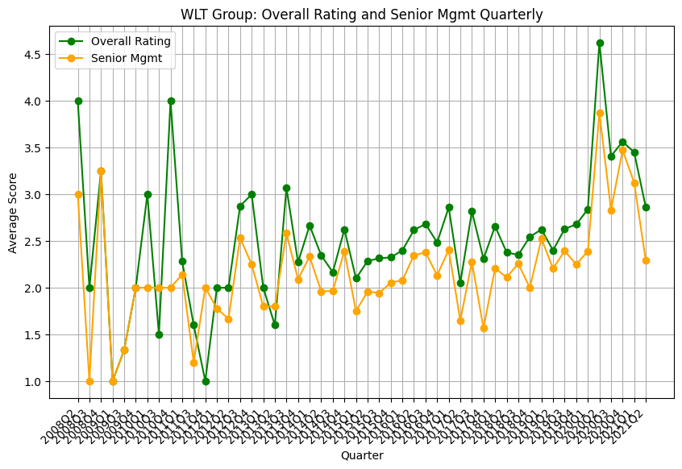
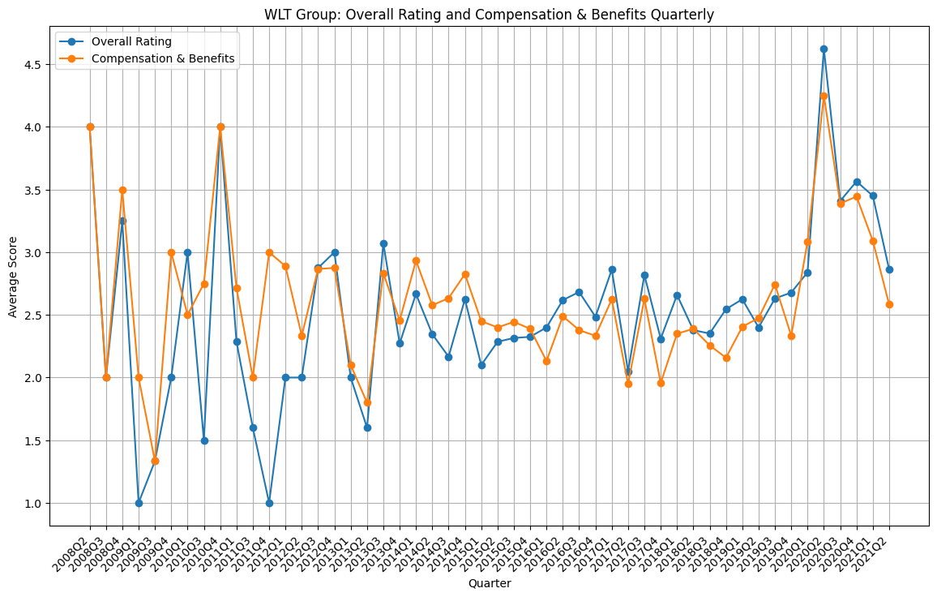
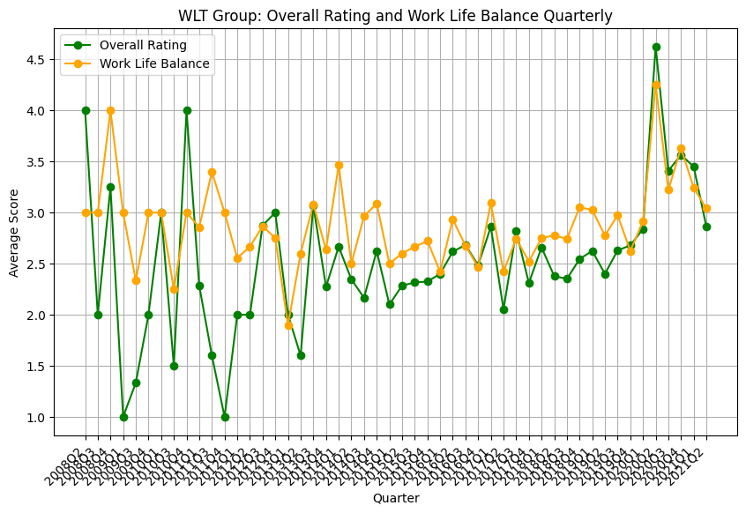
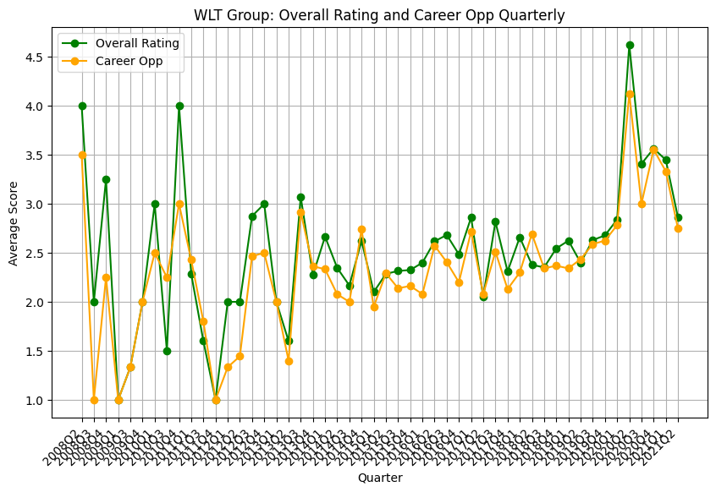

Slide 13
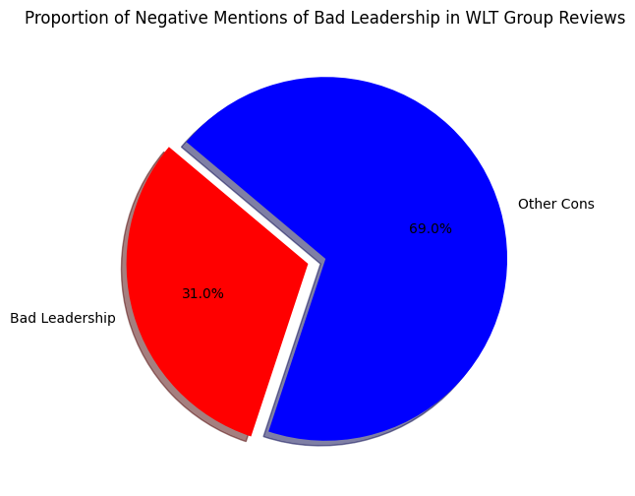
Bad Leadership?

Slide 14
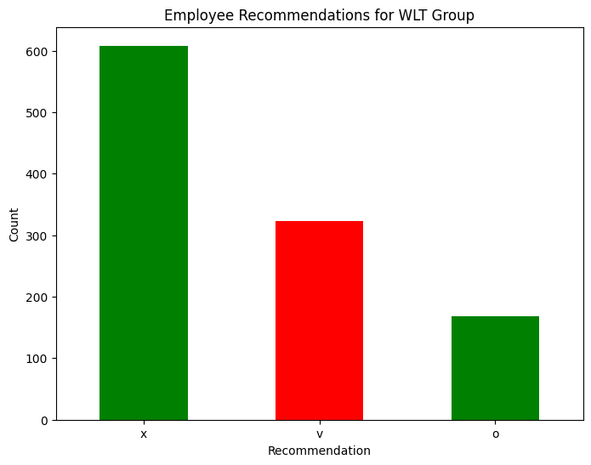
Employee Biases?

Slide 15
Employers now recognize the risks of disengagement and the potential benefits of fostering deeper connections between employees and their work.
However, there are concerns about the lack of rigor in defining and implementing engagement strategies. Without a clear understanding of its goals, processes, and potential downsides, engagement risks becoming a fleeting trend.

Slide 16
Recomendation
Benchmark Against Top Performers: Compare your company’s overall ratings and employee feedback with the top 5 companies to identify areas for improvement.
Focus on Employee Satisfaction: Invest in initiatives that improve employee satisfaction, such as better work-life balance, competitive compensation, and career development programs.
Maintain Consistency: Ensure that your company collects and monitors employee feedback consistently over time. This will help you track progress and maintain a positive employer brand.
Promote Strengths: If your company is among the top performers, highlight your strengths in employer branding and recruitment campaigns to attract top talent.
Address Weaknesses: For companies not in the top 5, analyze the gaps in employee satisfaction and implement targeted strategies to address them.

Slide 17

How can this analysis benefit ”US”
1. Predicting Employee Sentiments
2. Financial Analysis Using Satisfaction Data
3. Predicting Company Ratings & Cultural Values
4. Forecasting Review Volumes
5. Integration with Financial Data

